Slide 1

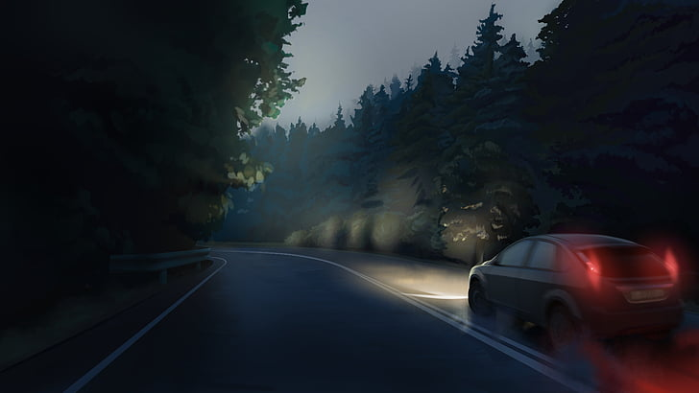
Drowsy Driver Detection to Prevent Road Accidents(Progress After C1)
Under the guidance of - Dr. Rajat Kumar Singh
Group -
Aayush Raj (IEC2018022)
Shikhar Srivastava (IEC2018024)
Ved Prakash Verma(IEC2018028)

Slide 2
Modification Made after the C1 panel suggestion
As per the suggestion received by the panel members we decided to change the way of implementation of our project.
Previously we were implementing our project using Arduino and several sensors which needed to be wore by the driver to detect the downiness .
Now we are implementing our project using Raspberry pi which doesn’t require any wearable sensor to detect the drowsiness.

Slide 3
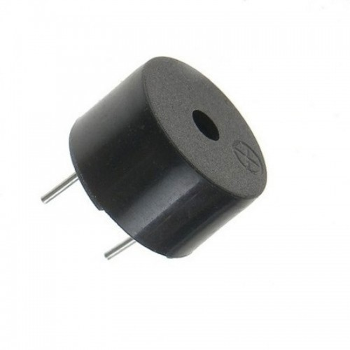
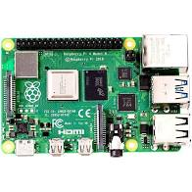
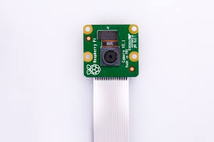
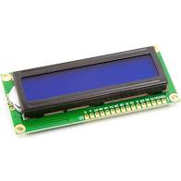
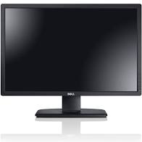
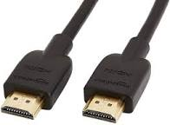
Modified Project Work flow
Raspberry Pi- Process the video input and detects drowsiness based on the code
Alerts the Driver that he is drowsy
Alerts the passengers and neighboring drivers
PI CAM – Takes the video input of the driver
Display used the view how the detection is being performed

Slide 4
Methodology
Software Implementation-
To Write a python code to detect the downiness based of
Eye Aspect Ratio
Yawning
For Buzzer
For LCD display
Hardware implementation-
To Integrate the hardware components
Buzzer
LCD display
With raspberry pi to alert the driver the he is drowsy

Slide 5
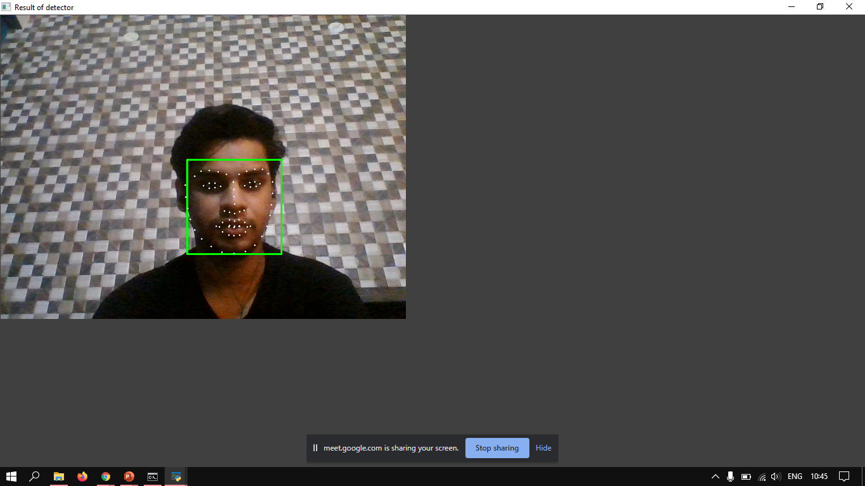
Software Model
Facial landmark detection is the task of detecting key landmarks on the face and tracking them. There are 68 facial landmarks points.
In our project implementation we took 6 landmarks for right eye , 6 landmarks for left eye, 4 landmarks for upper lips , 4 landmarks for lower lips.
Based of the the distances calculated from these landmarks we declare whether the driver is drowsy or not
We have Implemented the code with python and tested it.

Slide 6
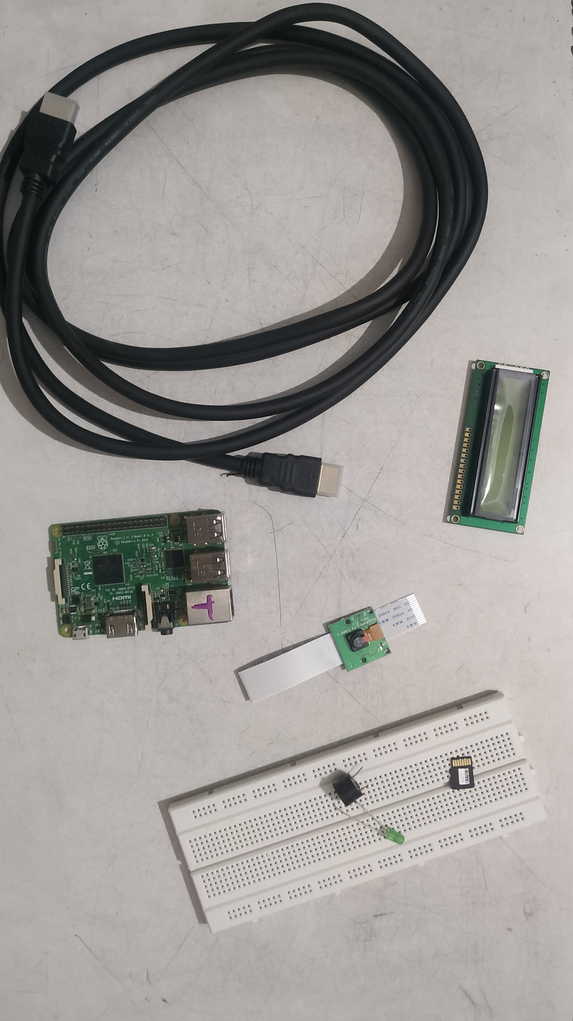
Hardware Model
By integrating these components together we are able to detect and alert the drowsiness of the driver.
The Hardware includes
Raspberry PI
PI CAM
LCD display
Buzzer
HDMI cable
Breadboard
Jumper Cables.
We are on the way of implementing it.

Slide 7
Work Done till Now
Implemented the python code for
Eye Detection
Yawning
Tested the code on several people and obtained satisfactory results.
Started the hardware implementation

Slide 8


